Slide 1
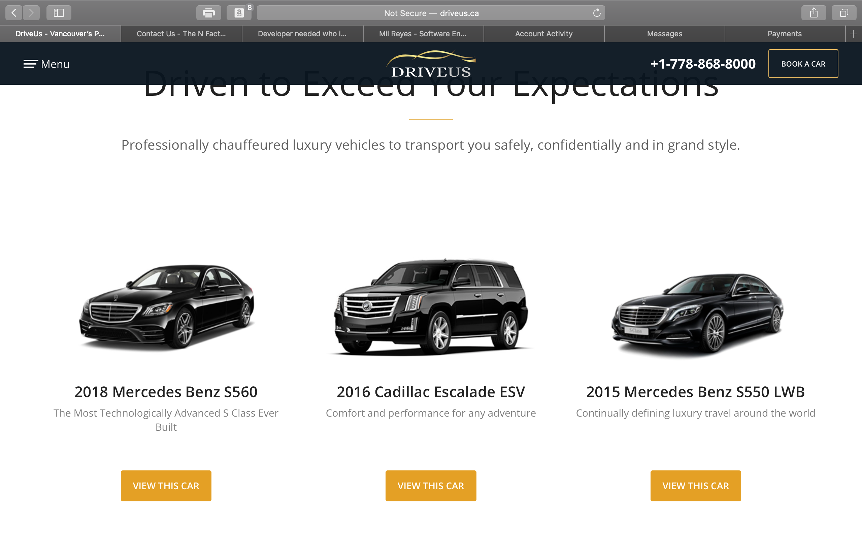
Notes:
On the screenshot below change photo of 2018 Mercedes Benz S560. Change the year on the 2016 Cadillac Escalade to 2018. Remove the 2015 Mercedes Benz S550 and replace it with a 2018 GMC Denali XL.

Slide 2
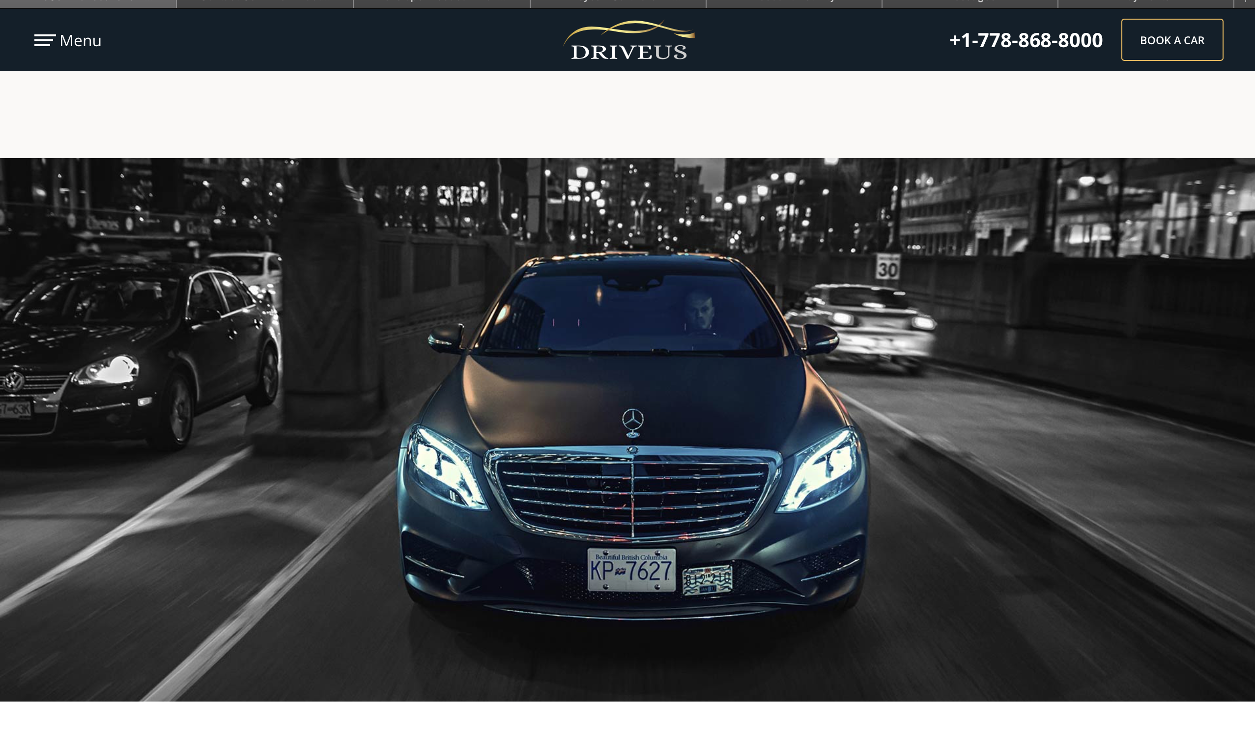
Notes:
Change this photo to new photo to be provided. ( All Matte Benz Photo's are to be removed from the website as we just sold the car).
1A1A7630.jpg

Slide 3
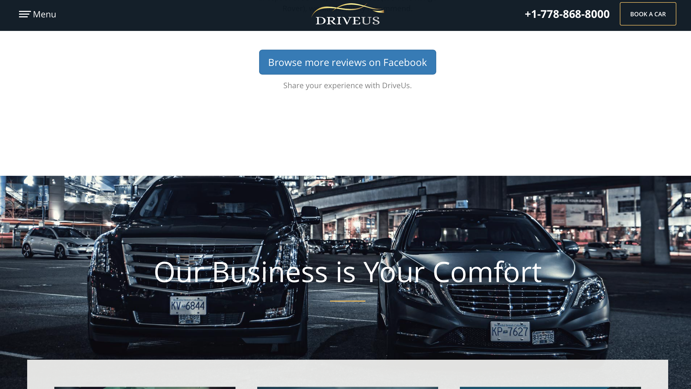
Notes:
Remove this photo in the background of the Matte Benz and Cadillac Escalade and replace with new photo to be provided

Slide 4
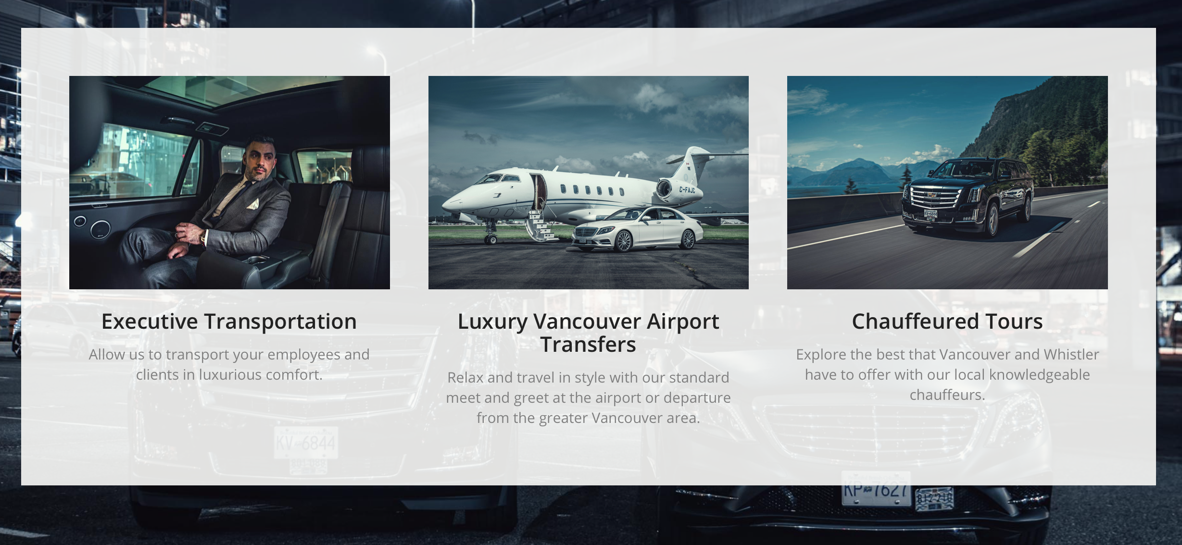
Notes:
Remove middle photo of white benz and private jet and replace with photo to be provided

Slide 5
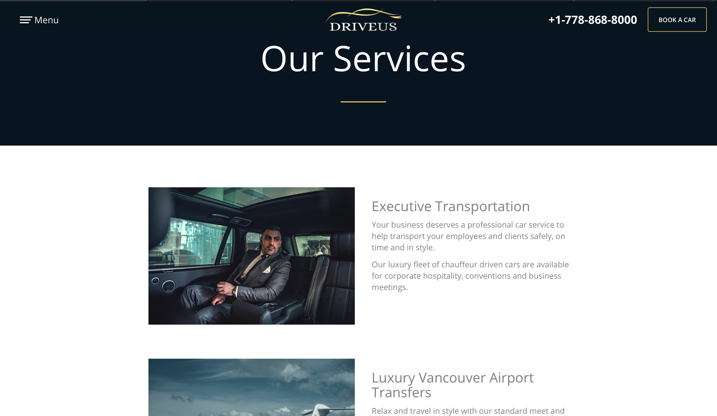
Notes:
on the our services page remove the white benz and private jet photo with photo to be provided

Slide 6
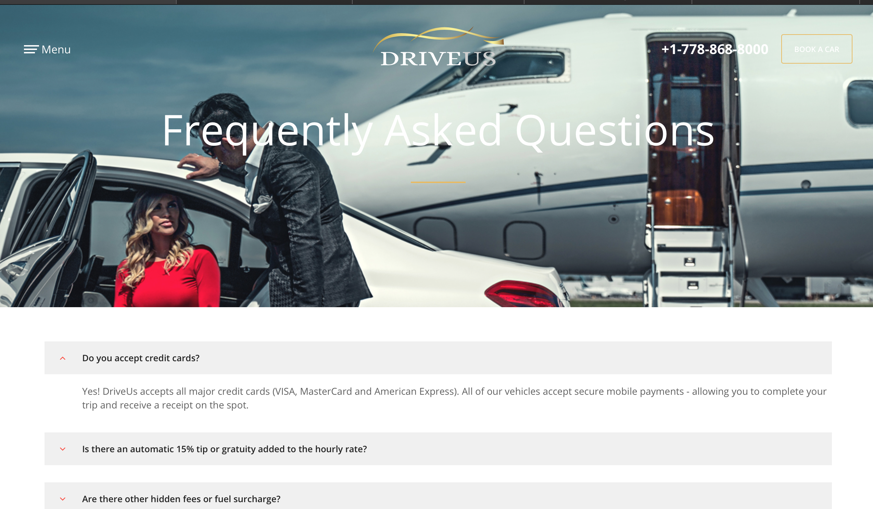
Notes:
On the FAQ page remove photo of girl in red dress by private jet and replace with photo to be provided *** the print gets lost in the private jet colour white needs contrast and that car is no longer with us

Slide 7

Notes:
change this write up delete "includes all taxes" Will provide new content for this paragraph

Slide 8

Notes:
Change photo of interior of car on main page new photo to be provided. Would also like to see links in the top bar to instagram and FB

Slide 9
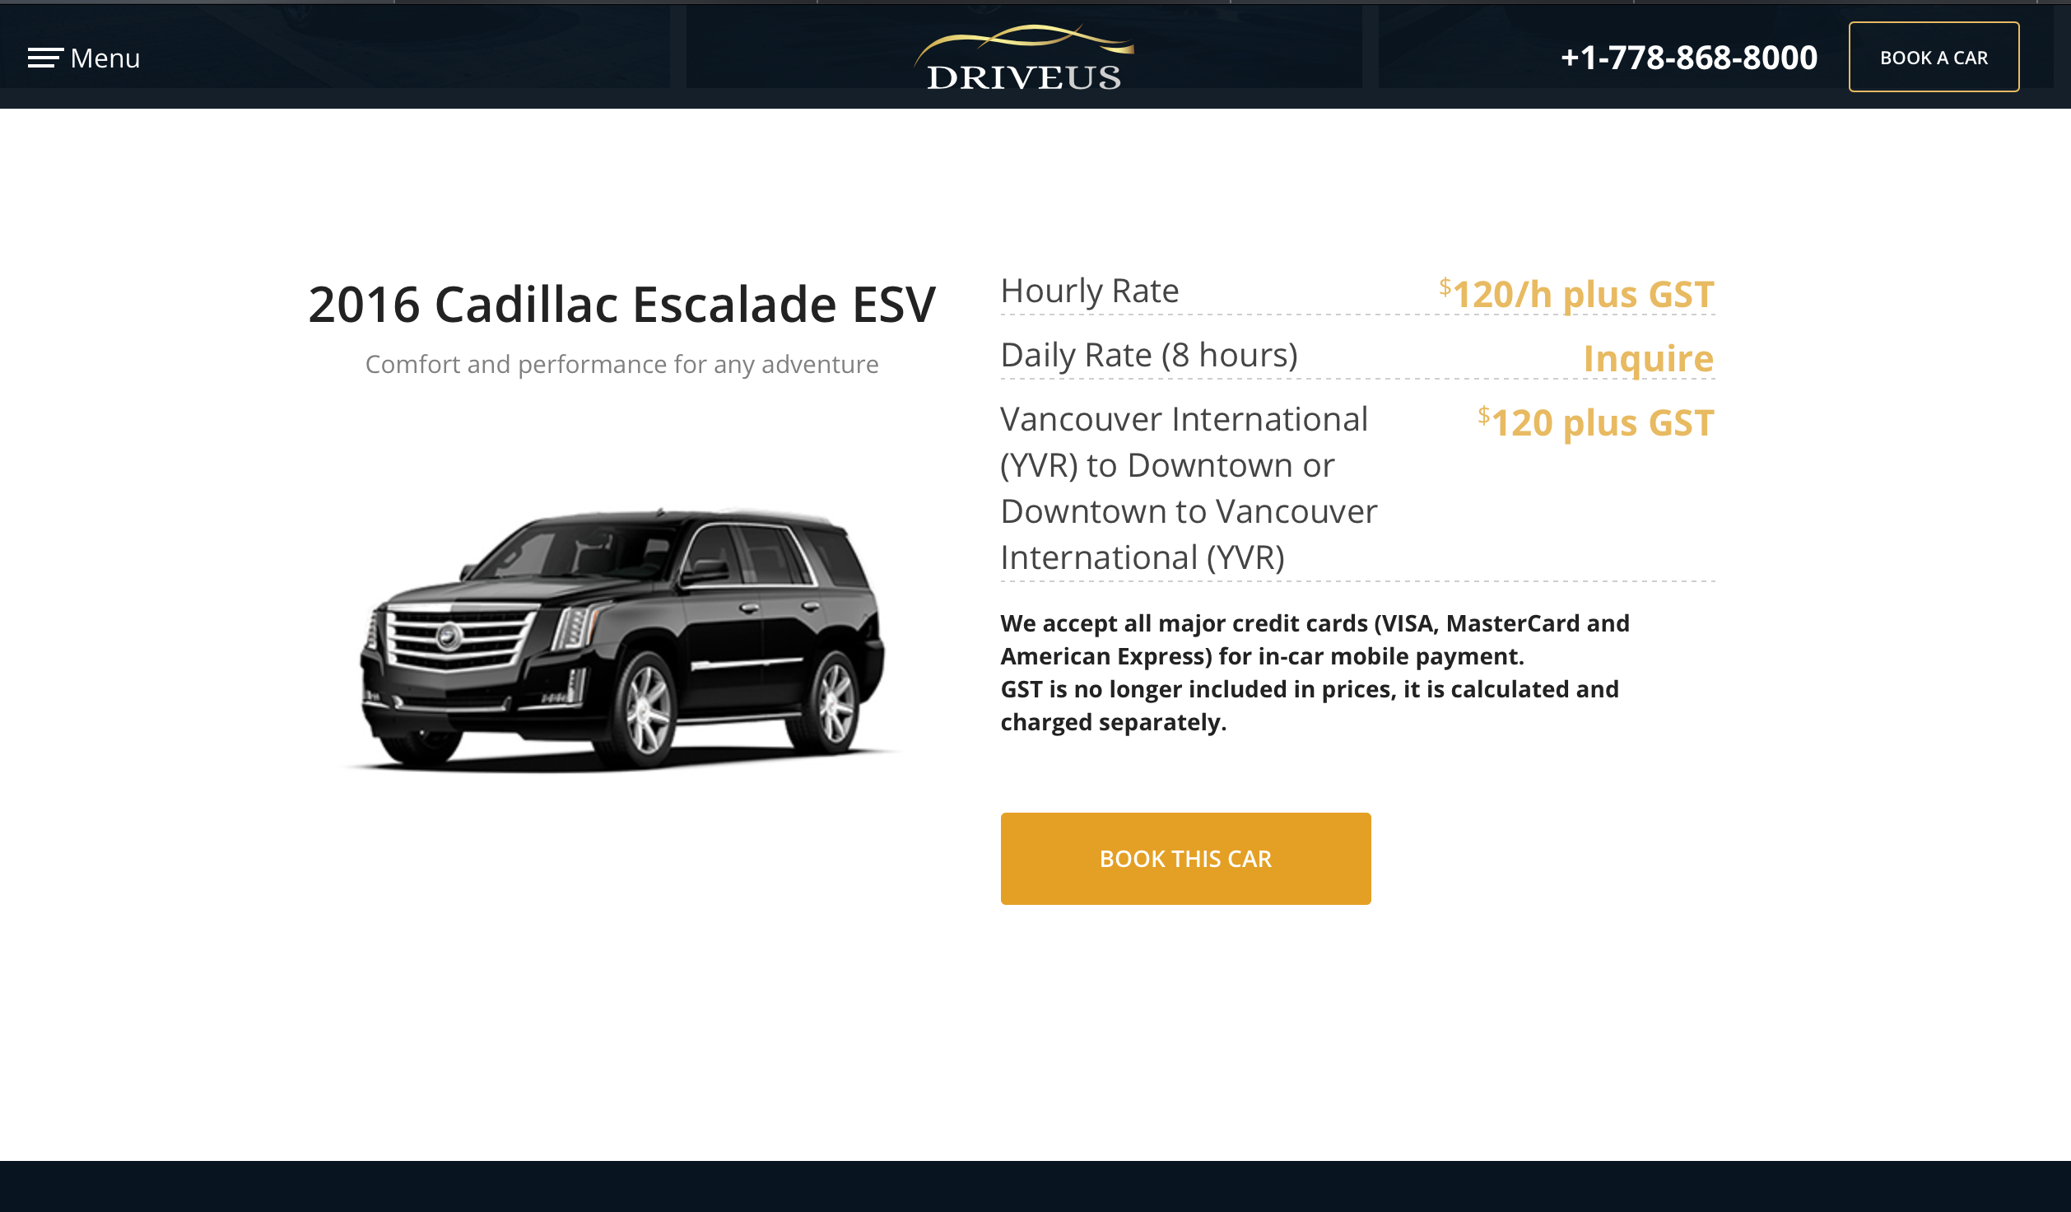
Notes:
Change the hourly rate to $125 per hour
also change to 2018 Cadillac Escalade ESV *** anywhere on the site that mentions 2016 please change to 2018

Slide 10
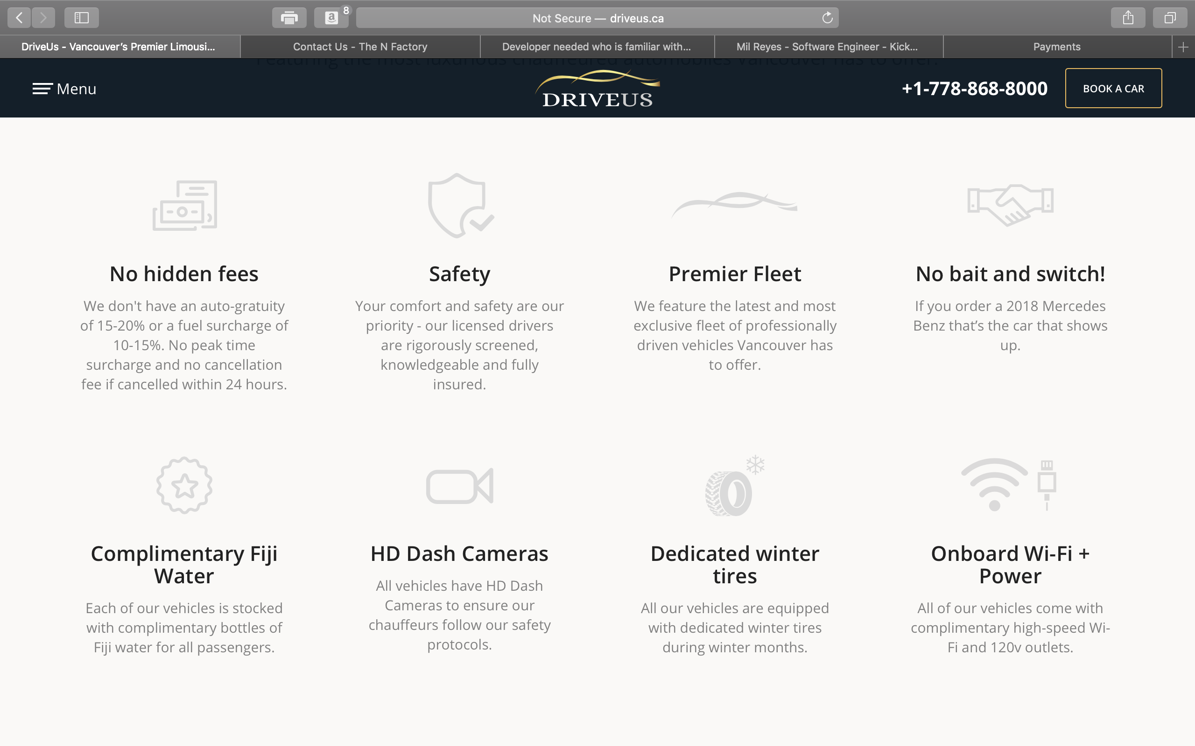
Notes:
Change HD dash cams to read 4K HD Dash Cams both headline and in the text. Replace bait and switch with sub heading "Live GPS Tracking" will provide the content for that later.

Slide 11
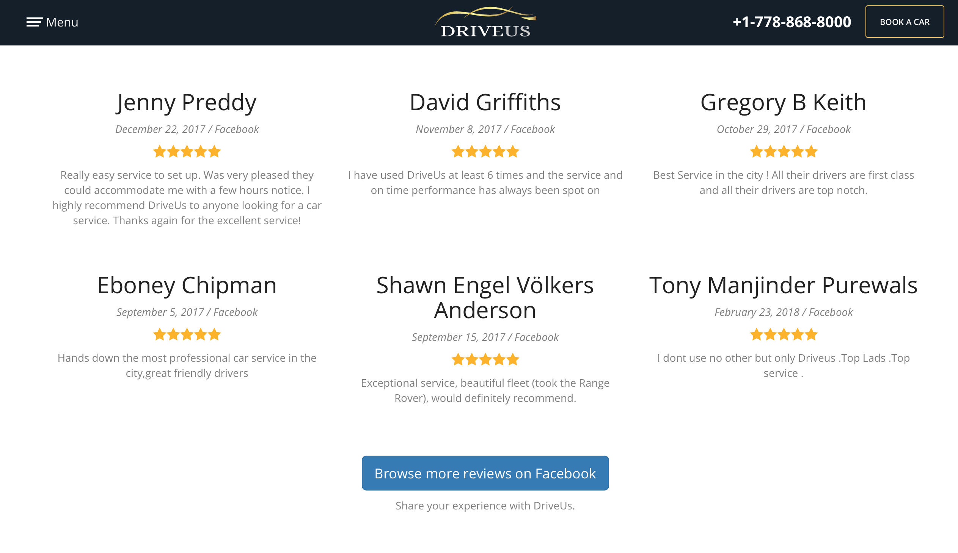
Notes:
Add a second button above browse reviews on facebook to Write a review on google. So clients can find where to leave reviews easier

